Slide 1
ChesT X-ray disease diagnosis
Pierson Wodarz, Steve Su, Atashi Rana
Notes:
In this presentation we will discuss the use of deep learning models for chest x-ray disease diagnosis
We performed this classification using a multitude of models for comparison between binary pneumonia classification and multilabel classification
One novel approach we took was building a model which used multiple views and incorporated data from the EHR in an attempt to provide better classification performance

Slide 2
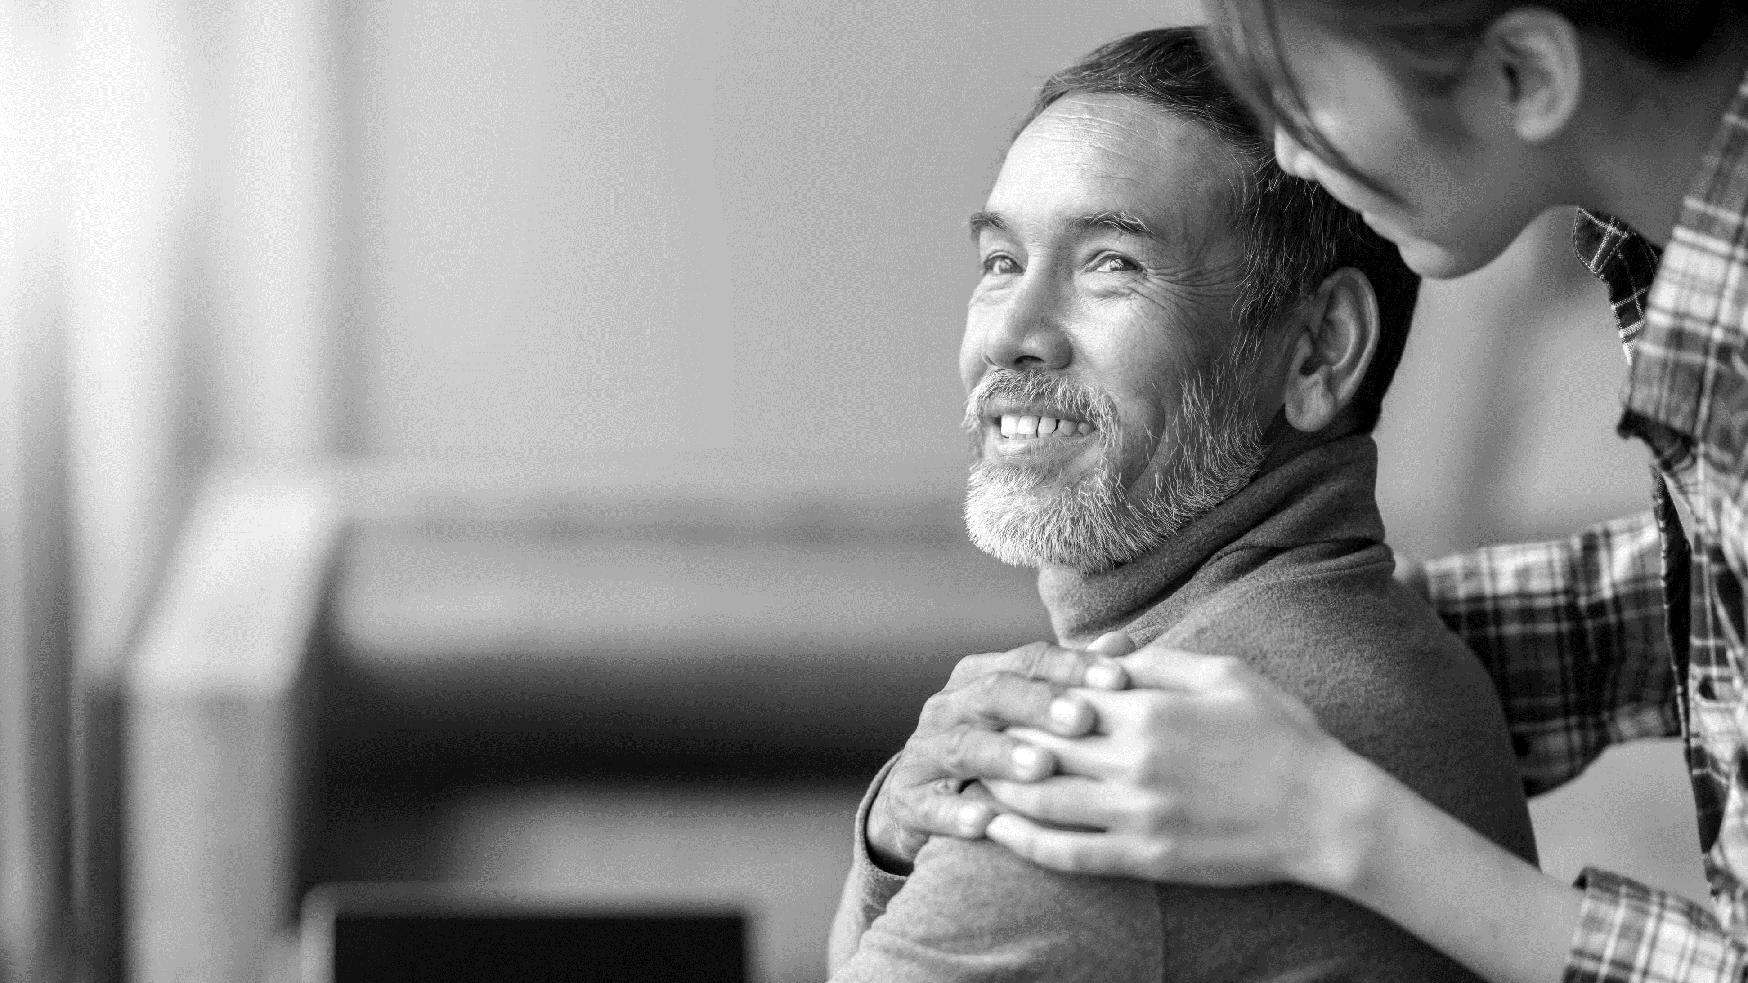
Agenda
Background and value proposition
Our approach
Understanding data
Models
Analytical model – comparison
Conclusion & optimization
Notes:
We will provide a brief overview of the drive and need for x-ray classification using deep learning techniques
We will provide an overview of the approach we took, how we handled the data, and ultimately the models we built to classify the data
We then compare the models and results and find opportunities for improvement and optimization

Slide 3



Background – drive towards value
Deep learning is creating new opportunities through commercially attractive solutions and playing a pivotal role to drive growth and value in the medical science
TRADITIONAL PROCESS
DEEP LEARNING
£ 2.3 B
£ 2.3 billion is spent on X-rays per year in UK
25 - 35%
It is expected to obtain a significant reduction in spend due to AI and deep learning techniques
1 -2
Days
On an average 1 – 2 days are required to get the x-ray report in a non-emergency situation
< 1 day
The turn around time for the x-ray reports will be significantly reduced
30%
On an average 30% of the radiology examinations are wrongly diagnosed
It is expected to reduce the diagnosis error to a minimal
WHAT THIS MEANS FOR PATIENTS
Patients can expect faster diagnosis of their x-rays thereby gaining speed to therapy at a reduced cost
and with higher accuracy
3
Notes:
Chest X-rays are very common and prevalent, and are a widely-used tool. In some countries, such as the UK, a large amount of money is spent on x-rays and readings by radiologists. Historically the process to read x-ray images has been on the order of 1-2 days, and there is lots of error
With deep learning techniques we can reduce error with well-trained models, provide faster turnaround, and reduce the expense of having a radiologist read the x-ray to provide a diagnosis. Such models can also provide value in areas in which radiologists are not available or are too expensive, such as developing countries.
Overall, deep learning models can become a tool in providers toolbelts to provide faster, cheaper, and more accurate services to patients.
Source: https://www.privatehealth.co.uk/conditions-and-treatments/chest-x-ray/costs/
https://rosettaradiology.com/rosetta-radiology-blog/how-long-does-it-take-to-get-test-results-for-a-procedure/#:~:text=In%20an%20emergency%2C%20the%20test,be%20reviewed%20with%20your%20radiologist.
https://www.ajronline.org/doi/full/10.2214/AJR.12.10375#:~:text=CONCLUSION.,practice%20averaging%203%E2%80%935%25.
Why 25 – 35% - There are 4 steps in radiology - Physical Imaging – Image processing – Reading by Radiology – Diagnosis classification and report generation

Slide 4
Our approach
We have taken an approach involving data mining, metric identification and analytical model comparison for use in Chest x-ray analysis
01
02
03
04
05
Data Gathering
Data Processing
Metric Identification
Model Building
& Training
Output Analysis
Collection of labeled data of chest x-rays
The full data extract has 224k images w/ 14 common chest radiographic observations
Patient population of 65k
A subset of data is considered for training the model
A subset of 10k patients are selected w/ 40k images
Images are center cropped and downscaled before feeding the model
Accuracy
AUC
F1
Built 8 Models:
Binary Simple CNN
Binary Extended CNN
Binary ResNet18
Binary DenseNet121
MultiLabel Simple CNN
MultiLabel Extended CNN
MultiLabel ResNet18
Multilabel DenseNet121
Trained the models until loss plateau
Analyze the performance of the models based on metrics – Accuracy, AUC, F1
Challenges and improvement areas
Notes:
We followed a multistep approach to classify the x-rays and classify the results
First we gathered data, processed, chose the metrics to use for comparison and analysis, built the models – a simple CNN model, an Extended CNN model incorporating additional data beyond the other models, and a ResNet and DenseNet model in the hopes of replicating results by other researchers using those same models and to provide a point of comparison for our new extended CNN model. We built and trained models for binary classification of pneumonia, and multi-label classification of all pathologies in the dataset. Finally, we analayzed the performance of our model against the evaluation metrics we had decided on earlier.
Metric identification: Accuracy, AUC, and F1 to be used for comparison between models, and between results from other researchers

Slide 5
Understanding & Processing Data
CheXpert Dataset
Subset Dataset
Image Standardization
65,240 Patients
224,316 images
14 common chest radiology observations
Labels (0 negative, -1 uncertain, +1 positive)
Labels are multi-label i.e each image can have multiple labels for different pathologies
1,000 – 1,500 patients
1,000 – 3,000 images
Consistent training and testing dataset for Binary classification tasks
Consistent training and testing dataset for Multilabel classification tasks
Center Crop
Downscale images to 224 X 224
Label – Pathology Name
0 No Finding
1 Enlarged Cardio mediastinum
2 Cardiomegaly
3 Lung Opacity
4 Lung Lesion
5 Edema
6 Consolidation
7 Pneumonia
8 Atelectasis
9 Pneumothorax
10 Pleural Effusion
11 Pleural Other
12 Fracture
13 Support Devices
Notes:
We used the CheXpert dataset, composed of many labeled x-ray images for 14 pathologies. The labels were determined by analyzing and extracting information from x-ray readings. For testing and training purposes, we used a subset of this overall dataset. We used different datasets for our binary and multilabel models.
Largest blocker in resources was dataset loading when training the model. Dataset sizes were increased to the maximum in which we could still run a reasonable number of epochs on google colab and see a loss plateau under the resource limitations in colab
We also standardized these images for use in our models and downscaled to improve processing and allow for feeding into the model

Slide 6
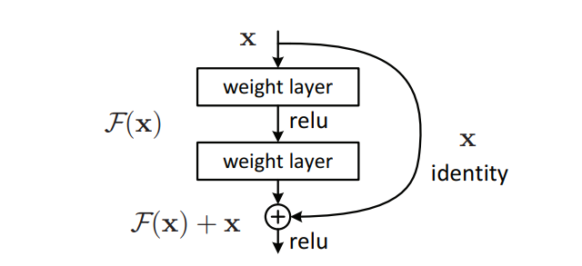
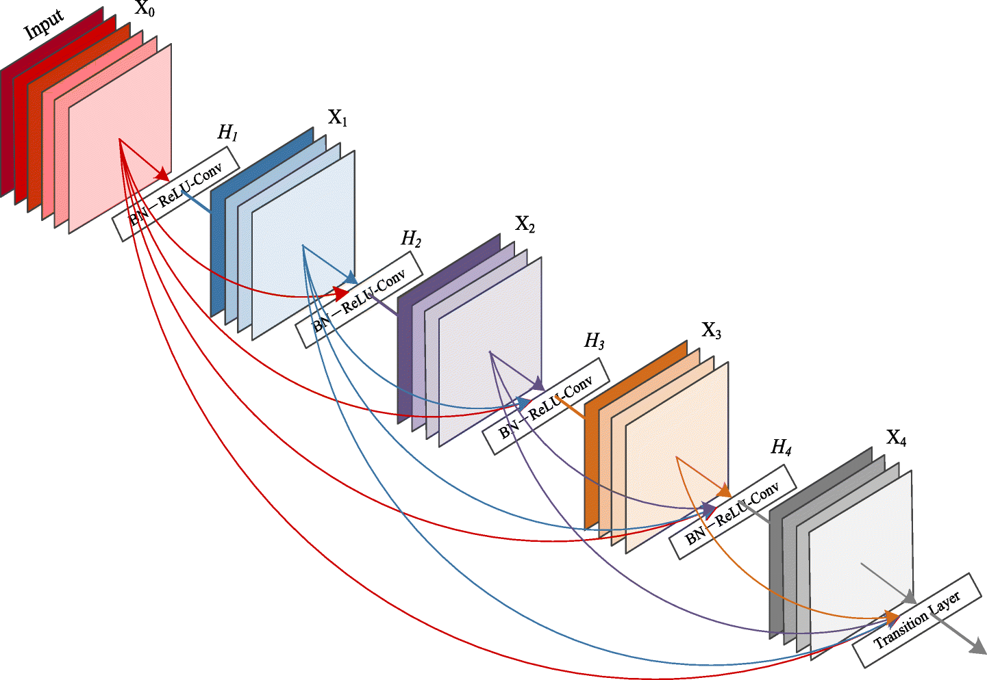
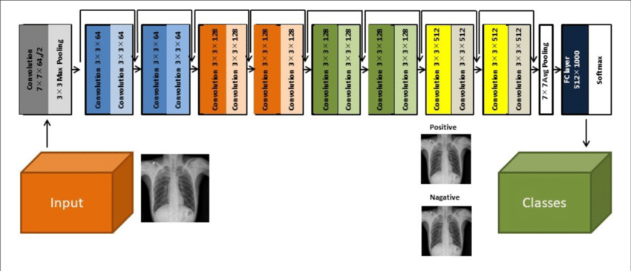
Models
We create both binary (for pneumonia classification) and multi-label models
Simple CNN
Extended CNN
ResNet
DenseNet
Three 2d convolution layers
8, 16, 32 feature map outputs
Each 2d convolution layer followed by a max pool layer and Relu activation
Flattened into vector and passed to the classification network of three fully connected layers
Connected layer followed by dropout layer and an activation function
Extends simple CNN model
Takes frontal and later images as 2-channel input
Normalized EHR data concatenated after third convolution layer (before passing to classifier)
Skip connection skips training and connects directly to output
Network fits the residual mapping
18 layer plain network architecture with skip connections added
Transition Layers and Denseblocks
Each layer connected to every other layer
All preceding layers are used as inputs
121 layer architecture with preceding layer connection
Notes:
Simple CNN provides a baseline
Standard structure with 3 2d layers and each layer is followed by a max pool layer and relu activation.
ResNet and DenseNet are approaches taken by other researchers. Used to replicate existing studies, and provide a performance comparison to the new extended model we built. They are designed to allow for training deeper neural networks, which provide better results on image classification tasks. They take different approaches for doing so, but have both been used to xlassify x-ray images.
Simple CNN, ResNet, and DenseNet are all trained on frontal chest x-ray images.
Our extended CNN model is our new proposed CNN model which takes the simple CNN model and incorporates additional data. This data includes lateral x-ray images and data from EHR such as gender and age, which were available in the provided CheXnet dataset. The image data is incorporated by modifying the simple CNN to accept 2 channel input. The EHR data is concatenated after the third convulational layer.

Slide 7
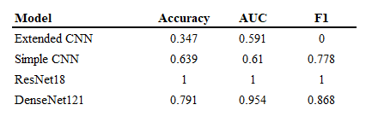
Binary Results
Key highlights
Extended CNN performed poorly, though similarly to the Simple CNN on AUC
Simple CNN did not approach state of the art, but returned reasonable results
DenseNet results were comparable with other researchers
ResNet results were impressive, and were further validated against additional data

Slide 8
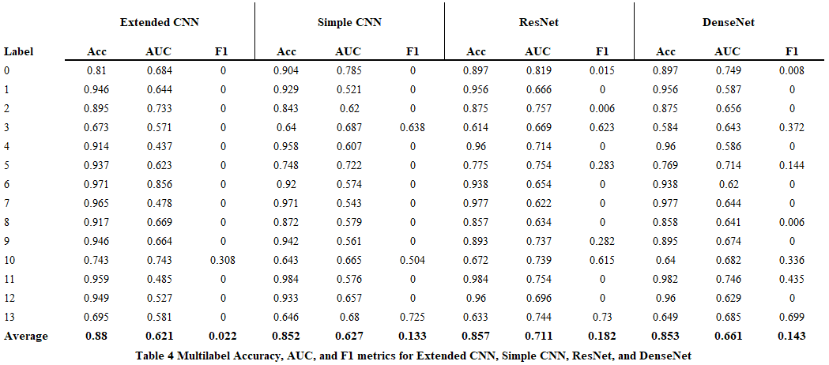
Multi-label Results
Notes:
Here we have our multi-label results for all models. We include all metrics for comparison, as well as the average across all pathologies.

Slide 9
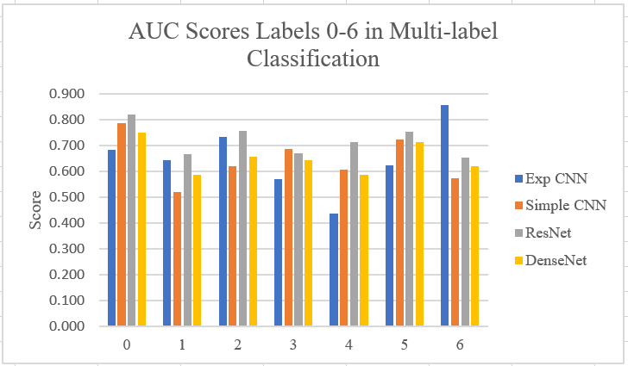
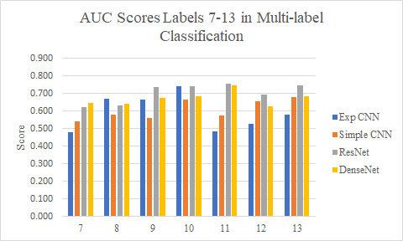
Multi-label Results
Key highlights
F1 score of 0 was common, indicating the models did not assign the label to any test data
ResNet model has highest performance on most metrics
Extended CNN led to a performance improvement in limited cases, but overall did not result in an increase in metrics

Slide 10

Conclusion
Extended CNN did not improve overall performance beyond state-of-the-art models like ResNet and DenseNet
ResNet and DenseNet results mirrored results from existing literature
ResNet still the go-to model for image classification
The Extended CNN model may have some utility in isolated cases (3/10 pathologies had higher AUC), with potential for further improvement
In some pathologies, lateral views may be more important
Optimization
Train on more data for more epochs
Incorporate additional data from the EHR in Extended CNN model
Physician notes, medical codes, additional views
Train on frontal and lateral views to increase utility of ResNet and DenseNet models

